Slide 1
Homeowner BMPs
Aileen Driscoll Farid
Jake Brinkman
Jennifer Hughes

Slide 2
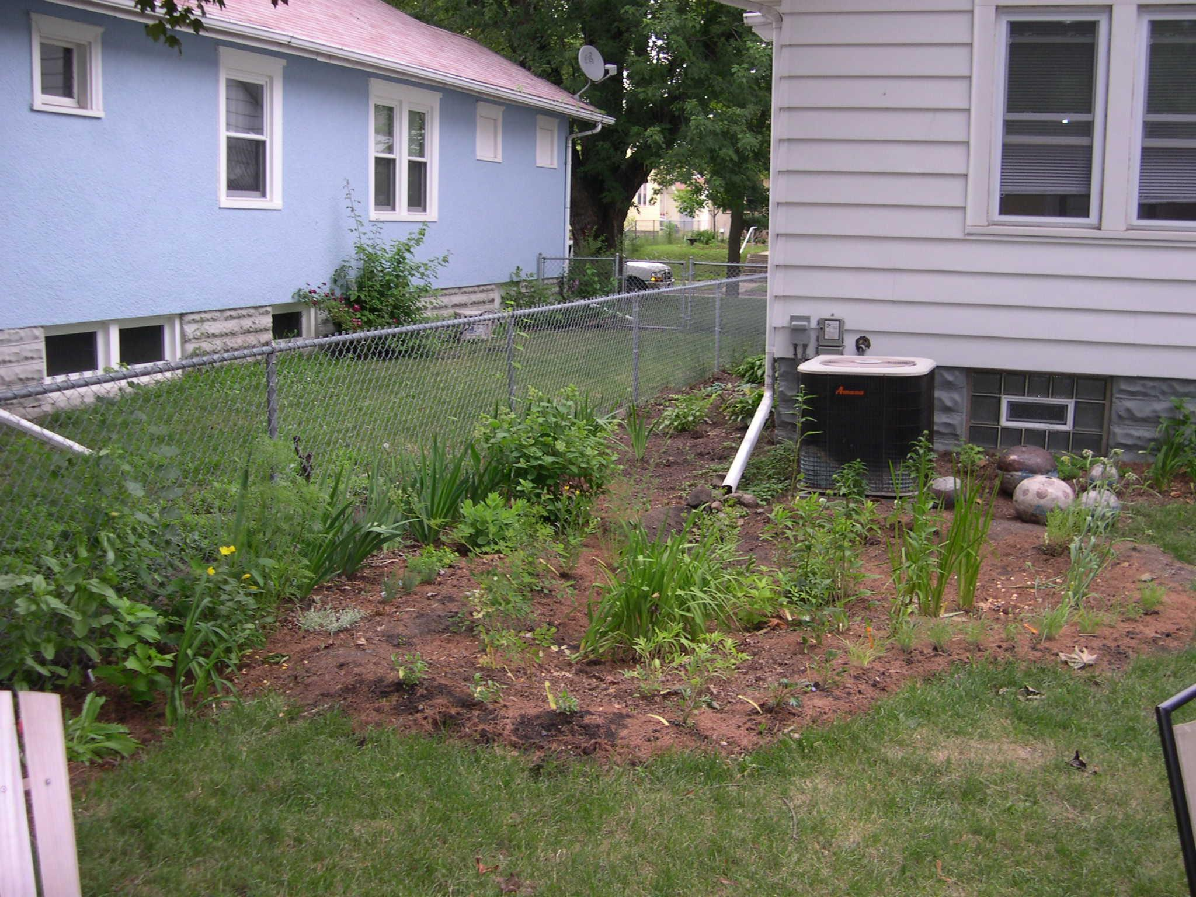
Introduction to project
BMP - Best Management Practice
Term used to describe a type of water pollution control

Slide 3
Introduction to project
Our project goal
Have a Brochure on Homeowner BMPs that can be used across Indiana
Brochure
Single brochure with an overview of popular BMPs for Homeowners that reduce Nonpoint Source Pollution (NPS)

Slide 4
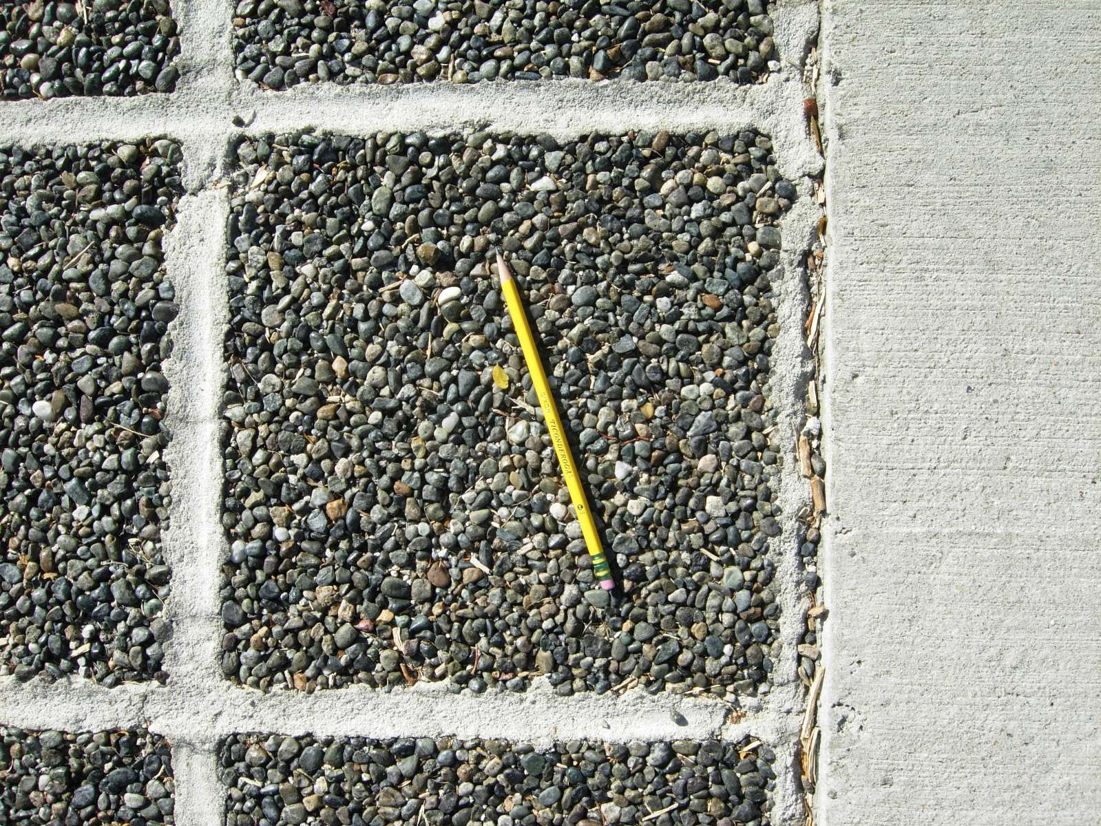
Homeowner BMPs
Rain Barrels
Rain Gardens
Mulching & Yard Maintenance
Porous Pavement
Filter Strips
Native Plants

Slide 5
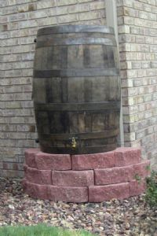
Rain Barrels
System that collects and stores rainwater from your roof that would otherwise run off and be diverted to storm drains, streams, and rivers.

Slide 6
Rain Barrels
Benefits:
Reduces runoff volumes
Conserves water for reuse
Provides irrigation water
Saves money and energy
Protects rivers, creeks, and lakes
Water is clean and fresh
Water is FREE!

Slide 7
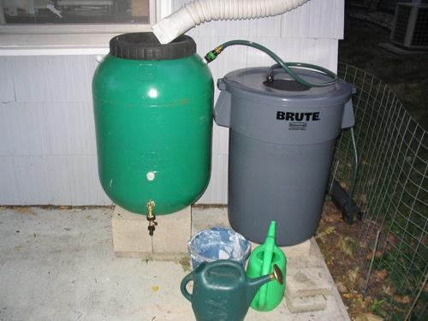
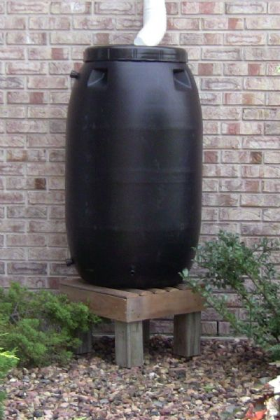
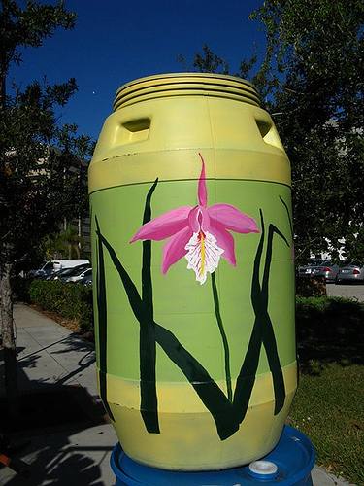
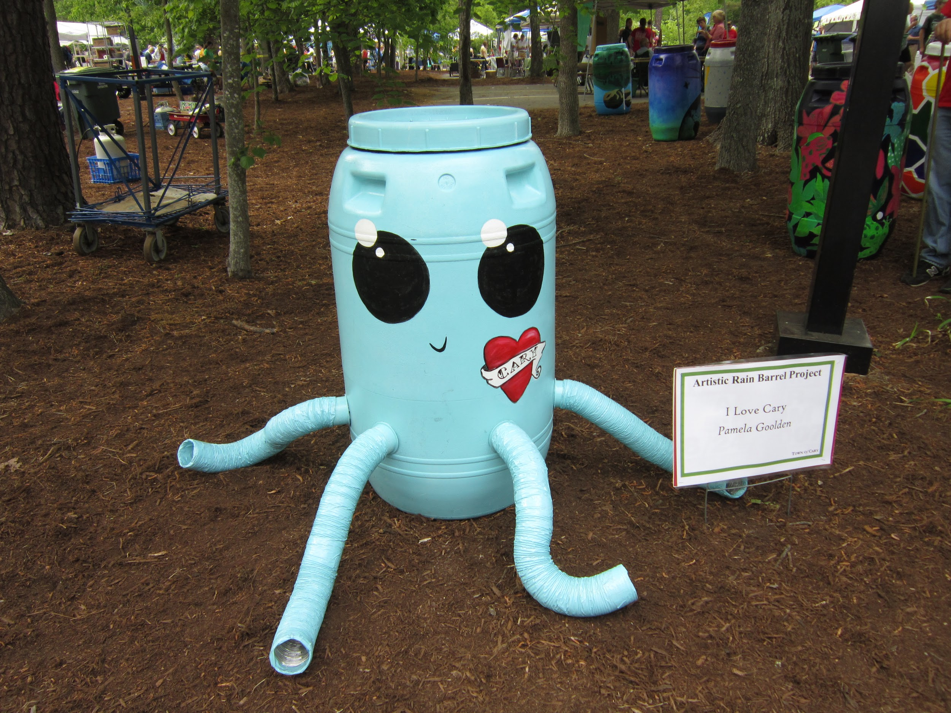

Slide 8
Rain Barrels
Place the rain barrel on one or two concrete blocks and then determine the proper height.
Cut the downspout at the proper height.
Attach the necessary elbows, extensions or diverter.
Install diverter according to manufacturer directions.
DONE!

Slide 9
Rain Barrels
Places to purchase
SWCD offices
Big Box Stores
Some small Hardware Stores
Internet
Side of road barrel seller
Cost
$25 (make your own) - $250 fancy

Slide 10
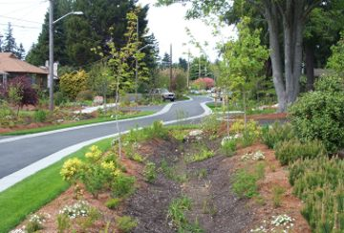
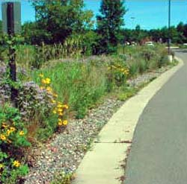
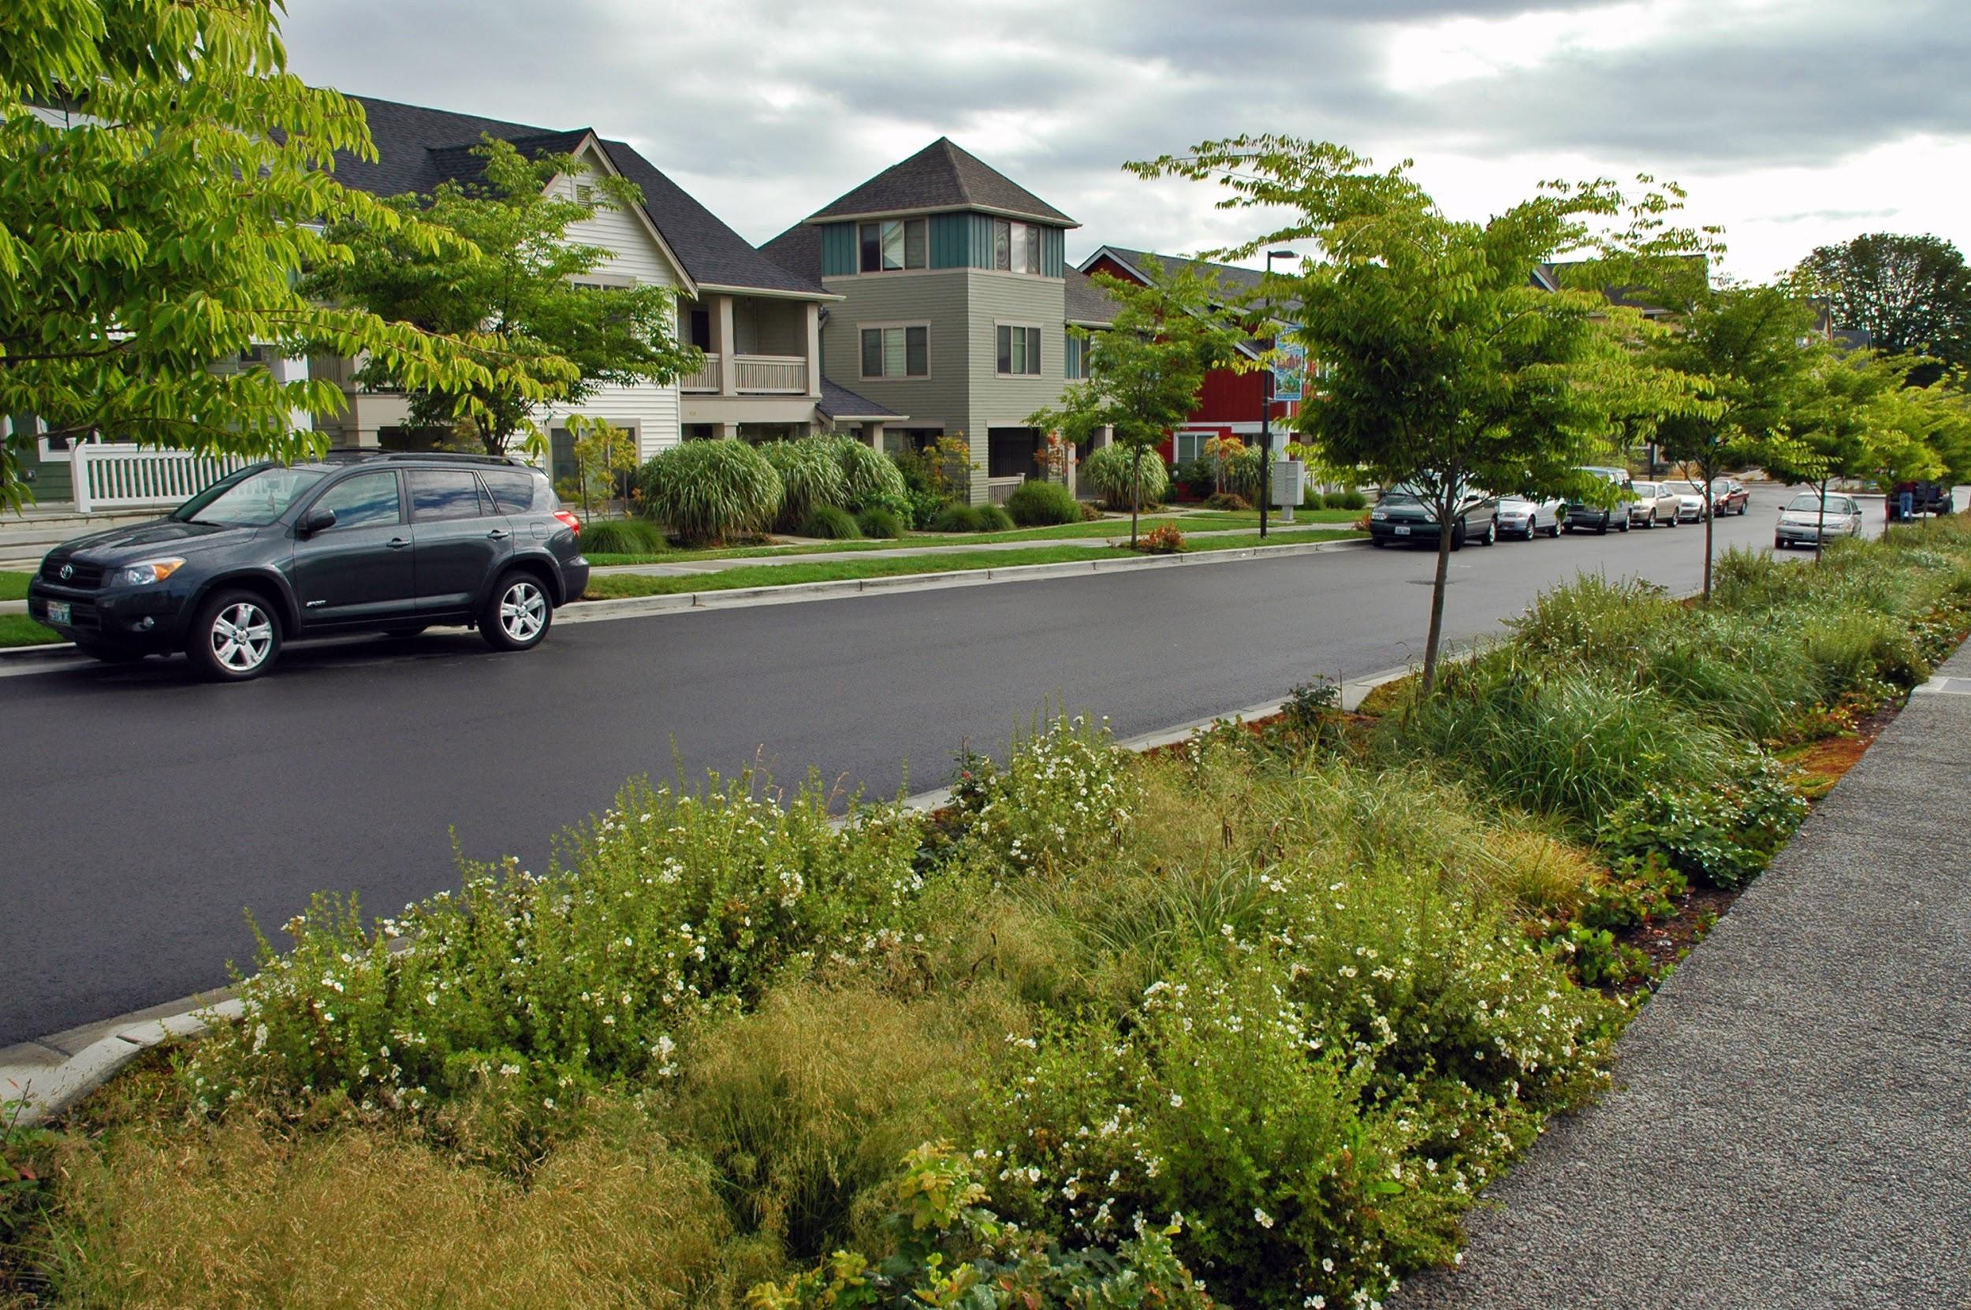
Filter Strips
An area of land containing grasses or native vegetation that slow the rate of runoff
Increase infiltration of runoff and nutrients
Promote sediment deposition and filtering
Can also serve as a buffer near waterways

Slide 11
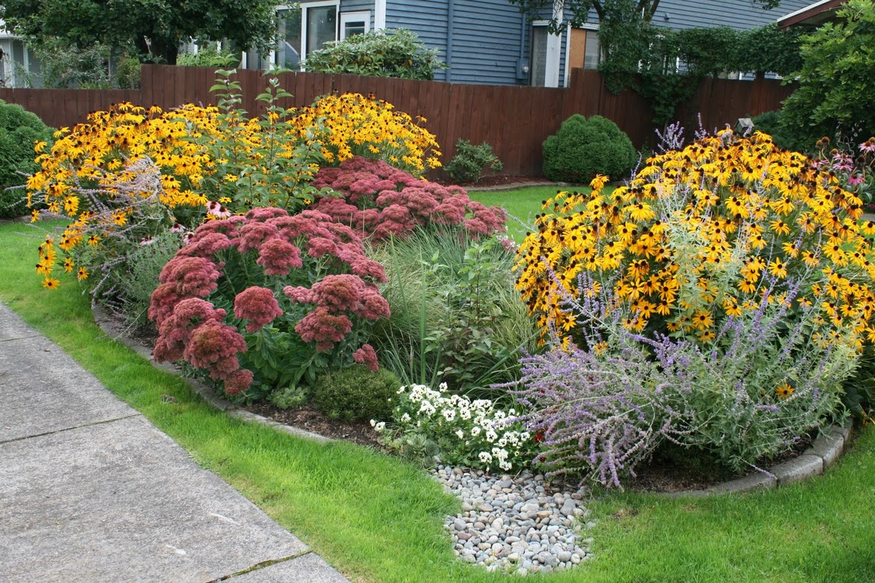
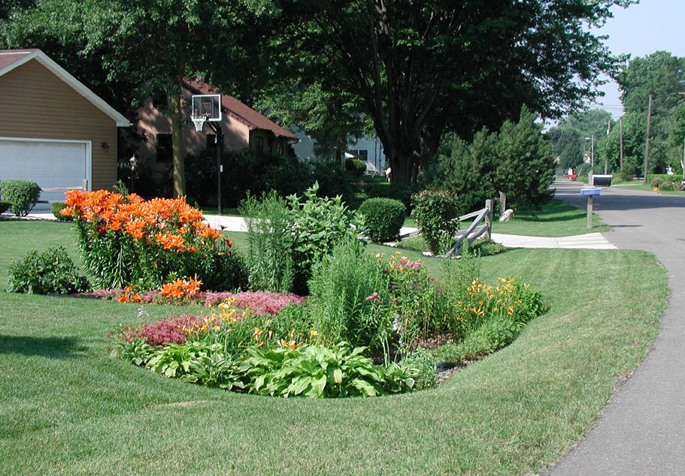
Rain Gardens
Planted shallow depressions designed to catch stormwater runoff in your yard

Slide 12
Rain Gardens
Slow down runoff by allowing it to soak into the ground, helping to prevent erosion
Plants filter pollutants like fertilizer, pesticides, and sediment out of stormwater
Attract beneficial pollinators like bees, butterflies, and hummingbirds
Provide habitat for wildlife

Slide 13
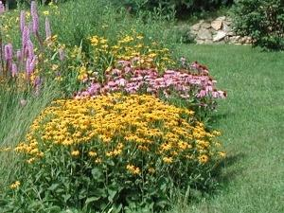
Native Plants
Are adapted to the local climate and soils
Many species are drought tolerant
Are easy to maintain once established
Have extensive root systems
that stabilize soil, reduce
erosion, absorb runoff water,
and filter out contaminants

Slide 14
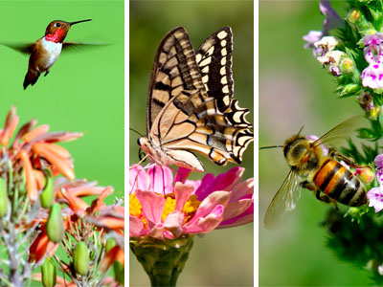
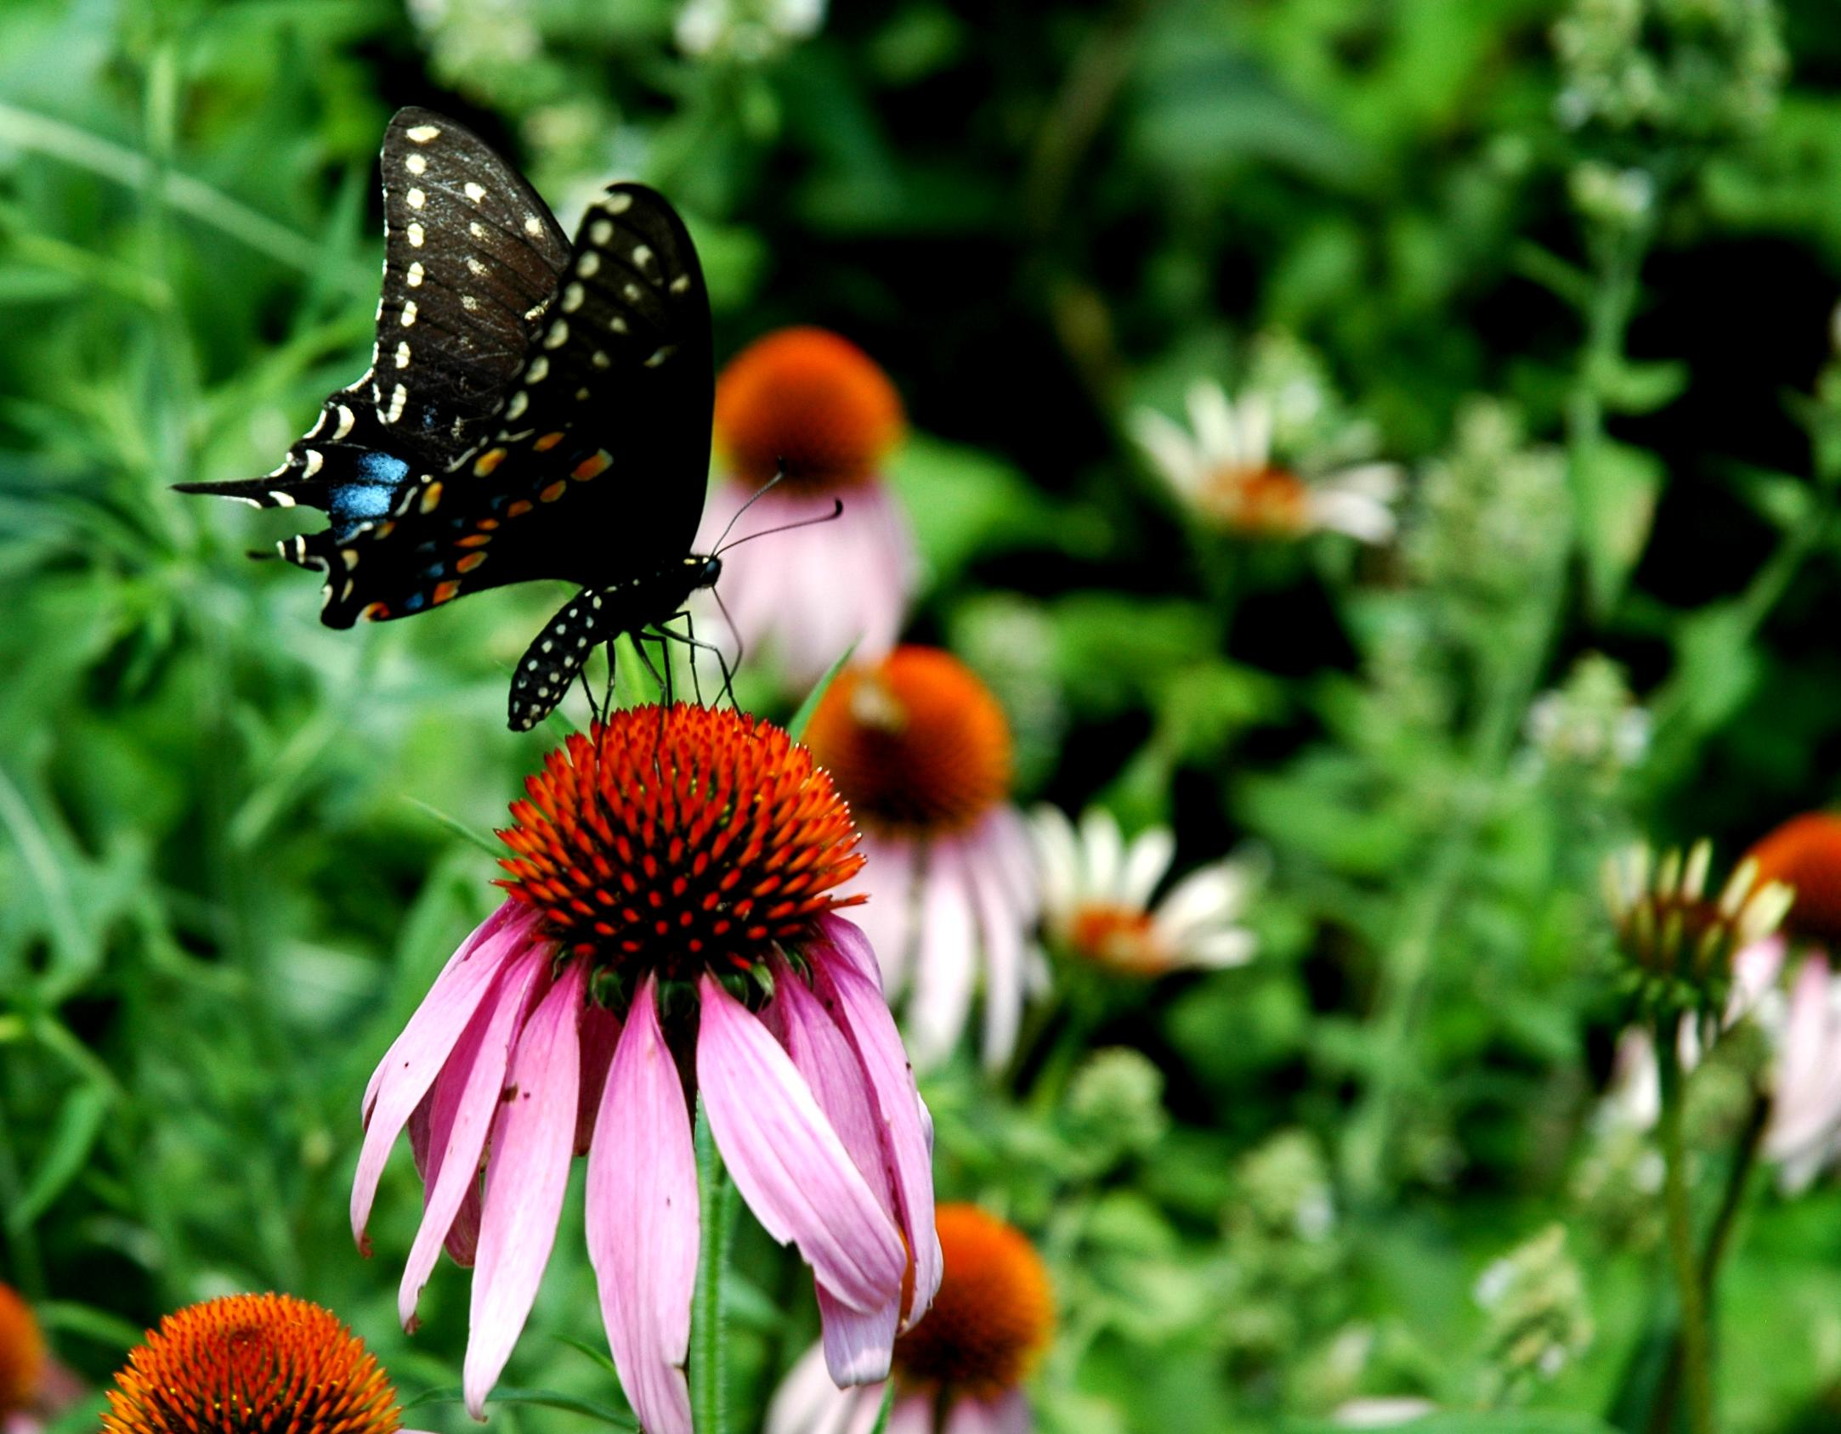
Native Plants
Many are host plants for caterpillars and nectar sources for butterflies, bees, and hummingbirds
Offer important habitat for songbirds
Perennials will come back every year!
Are an attractive way to beautify your yard!

Slide 15
Local Resources for Native Plants
Native Plants Unlimited - (317) 506-5456
Eagle Creek Nursery - (317) 291-7660
IMA Gardens & Greenhouse - (317) 920-2652
Indiana Native Plant and Wildflower Society www.inpaws.org (Annual plant sale in May)
Spence Restoration Nursery (for larger installations) www.spencenursery.com

Slide 16
How Much Do Native Plants Cost?
Inexpensive to start from seed
More expensive to purchase flats of potted plants from a nursery - mix and match to get a variety of different species
The price will vary depending on the size of the planting you are interested in doing
Call to get a quote before your purchase!

Slide 17
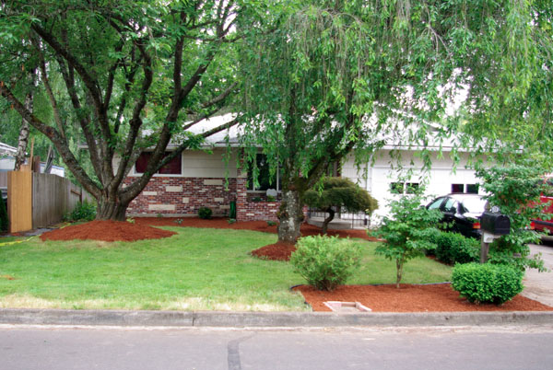
Yard Maintenance
Designing and caring for your yard using water quality BMPs that prevent erosion and reduce runoff
Low cost and minimal effort

Slide 18
Easy Ways to Do Your Part
Clean up after your pet
Don’t use more fertilizer than directed
Reduces nutrient loads
Increase green spaces-trees, plants
Slows runoff and increases infiltration

Slide 19
Raking Leaves and Grass Clippings
Reduces nutrient loads
City Leaf Collection Programs
Up to 40 bags/household Nov-Dec with trash pick-up
Can also be used as mulch
Keep out of drains and waterways

Slide 20
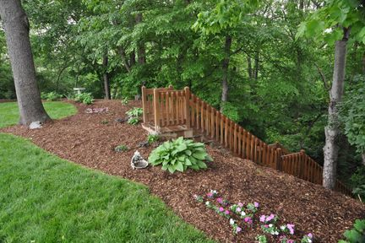
Mulching
Retains water
Prevents soil erosion
Aesthetically pleasing
Easy do-it-yourself
installation
Maintain by refreshing mulch layer as needed and each spring

Slide 21
Local Mulching Resources and Price
$20-$30/yard
Indiana Mulch and Stone
317-826-7777
Tiffany Lawn and Garden
317-228-4900

Slide 22
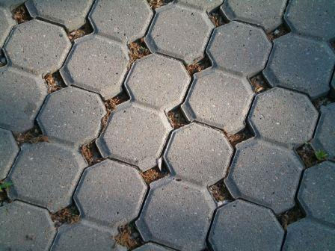
Porous Pavement
Permeable surface that reduces runoff by storing and filtering water
Can be used for streets, driveways, sidewalks
Regular maintenance required to function properly
Street sweeping or vacuuming
Professional installation

Slide 23
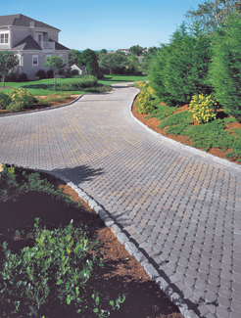
Porous Pavement
Resources
Professional installation
www.IRMCA.com

Slide 24
Additional Resources
Your local Soil and Water Conservation District (SWCD) http://www.in.gov/isda/2368.htm
City of Indianapolis Office of Sustainability http://www.indy.gov/eGov/City/DPW/SustainIndy/Pages/SustainIndyHome.aspx
Indiana Watershed Leadership Program
(Rain Barrel and Rain Garden Installation Videos)
https://engineering.purdue.edu/watersheds/videos.html
Your local watershed group

